Slide 1
Select

Slide 2
Uses
The SELECT statement in Oracle SQL retrieves specific data from tables.
Reporting: Generate reports by extracting specific data from one or more tables.
Analysis: Perform data analysis by aggregating, sorting, and filtering information.
Integration: Retrieve data for use in other applications or systems.

Slide 3
Different Ways Of Using SELECT
Basic
Aliases
DISTINCT
WHERE
ORDER BY
LIMIT / FETCH FIRST
Aggregate Functions
GROUP BY
HAVING

Slide 4
Select Syntax
Syntax
SELECT [column,] group_function(column),DISTINCT. . .
FROM table,tables…
[WHERE condition]
[GROUP BY group_by_expression]
HAVING [expression]
[ORDER BY column];

Slide 5
Basic
Syntax
SELECT column1, column2...columnN
FROM table_name;
SELECT *
FROM table_name

Slide 6
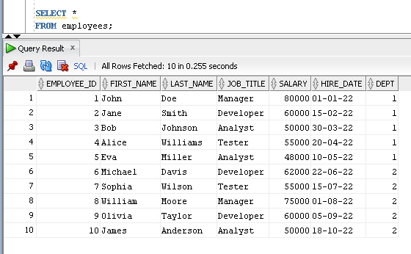
Example

Slide 7
Concatention
Syntax
SELECT column1 || ‘string’ || column2
FROM table ;

Slide 8
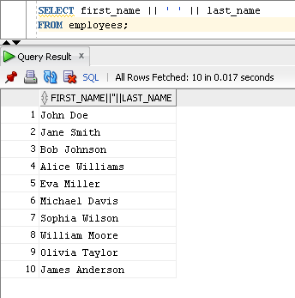
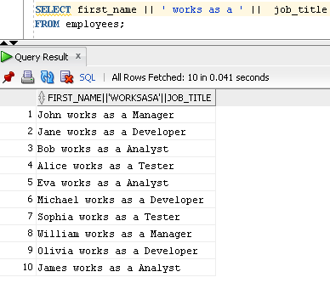
Example

Slide 9
Arithmetic Expression
Syntax
SELECT column1 + num, column2 - num,..
FROM table;

Slide 10
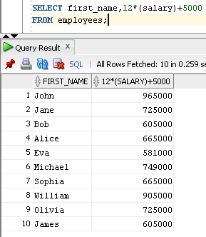
Example

Slide 11
Aliases
Syntax
SELECT column1 AS alias1, column2 AS alias2
FROM table_name;

Slide 12
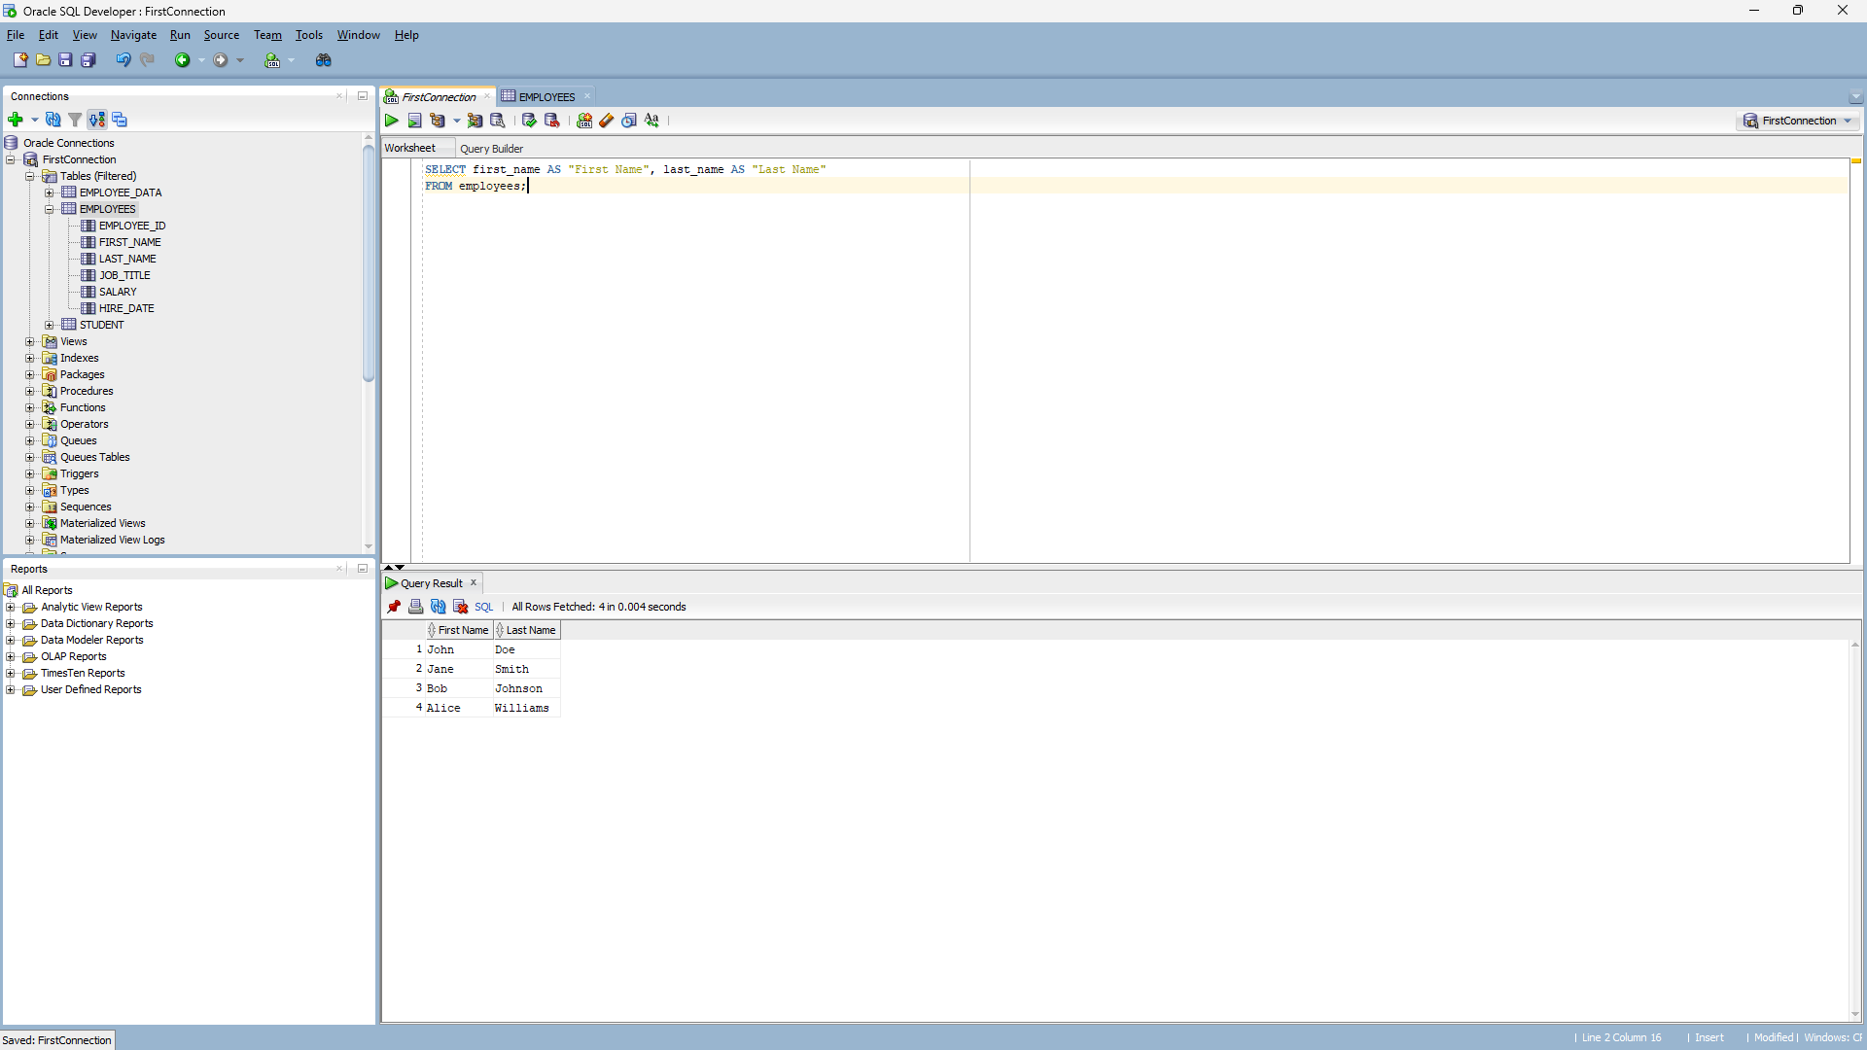
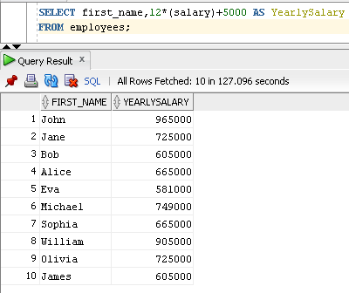
Example

Slide 13
DISTINCT
Syntax
SELECT DISTINCT column
FROM table_name;

Slide 14
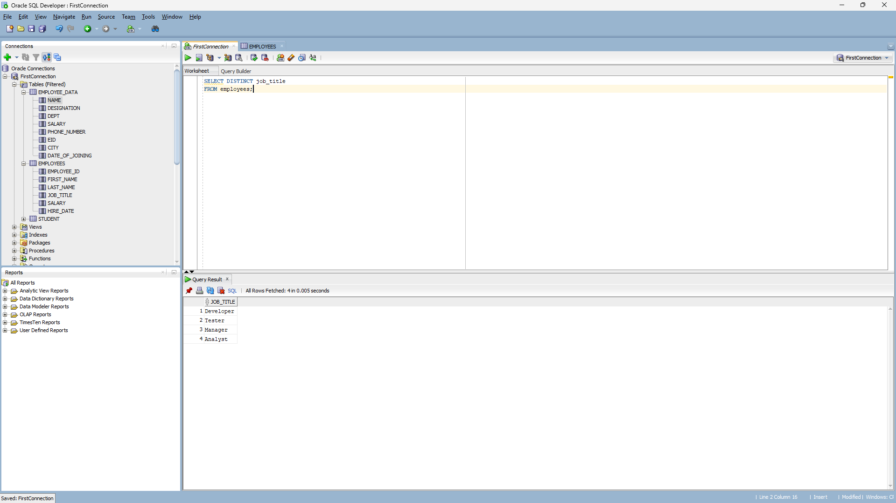
Example

Slide 15
ORDER BY
Syntax
SELECT column1, column2
FROM table_name
ORDER BY column1 [ASC | DESC];

Slide 16
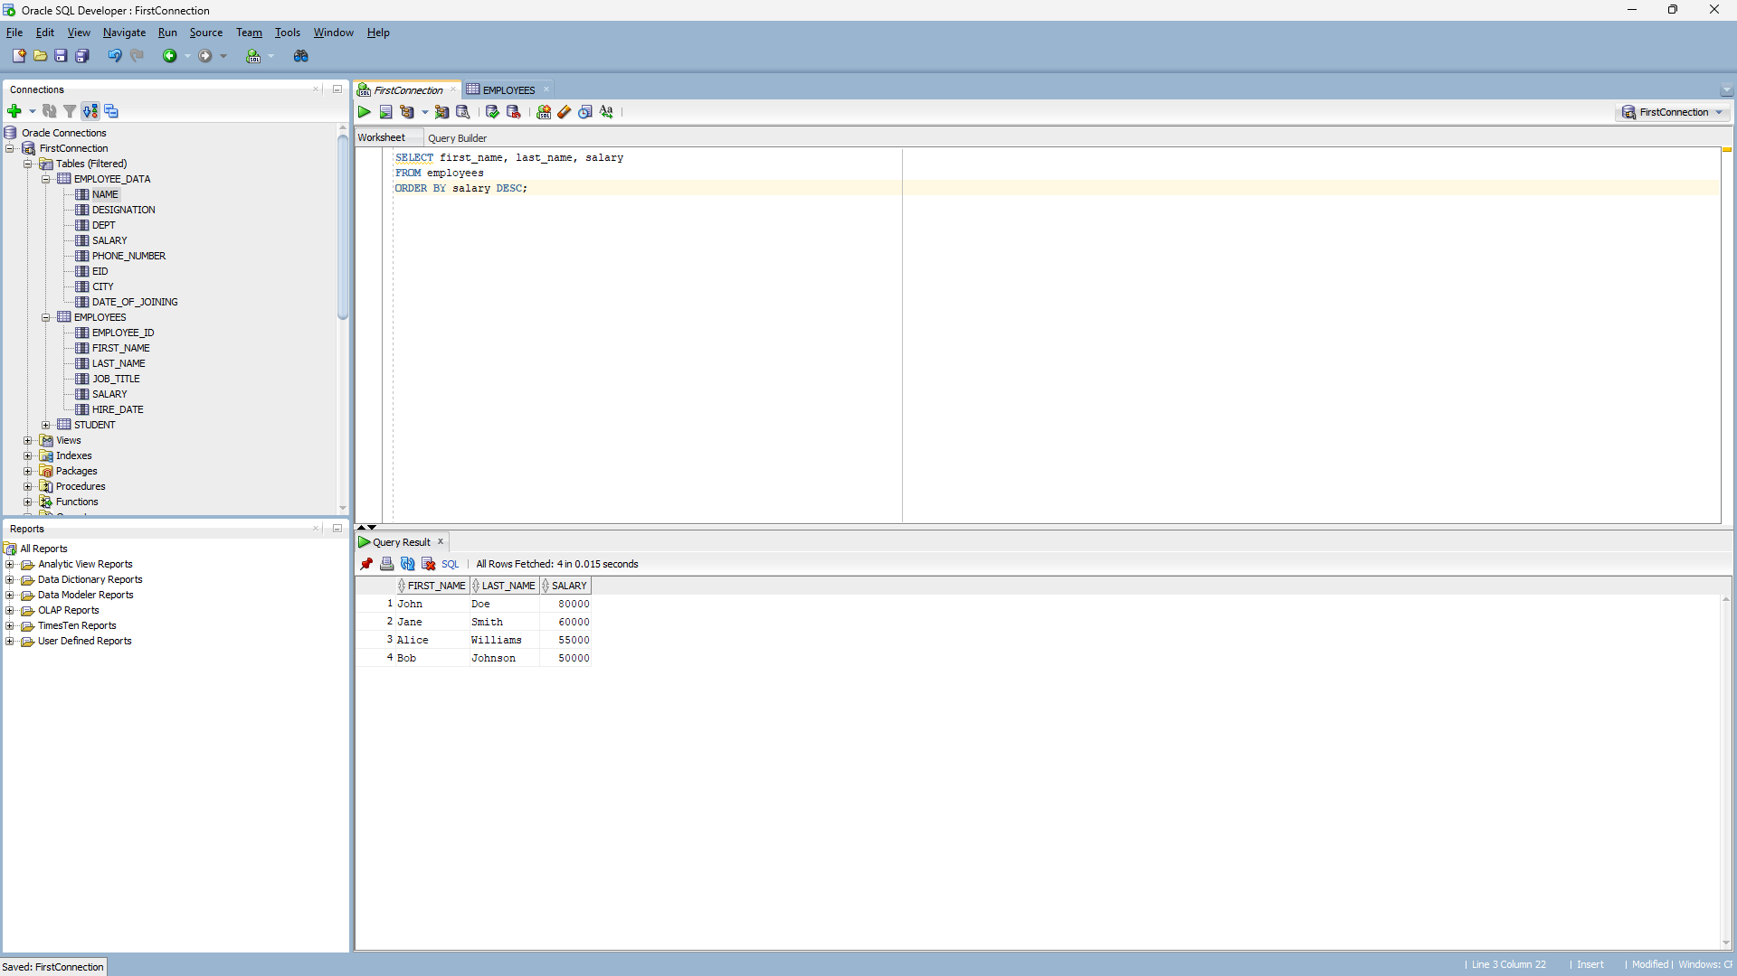
Example

Slide 17
WHERE
Syntax
SELECT column1, column2
FROM table_name
WHERE condition [AND cond2…,];

Slide 18
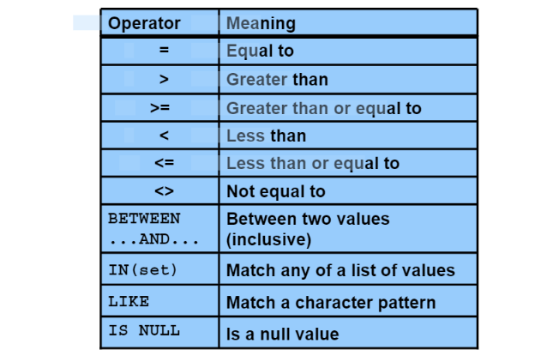
Comparison Operators and Conditions

Slide 19
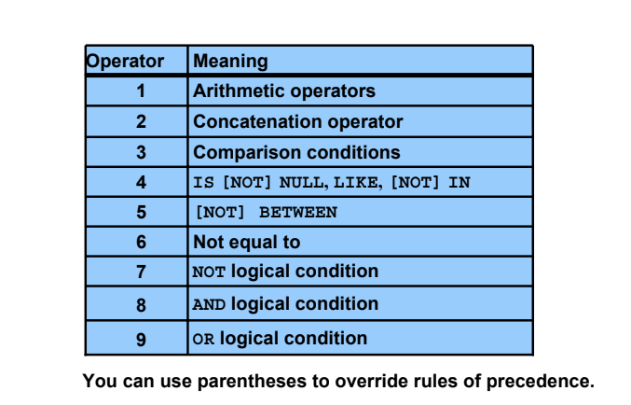
Rules of Precedence

Slide 20
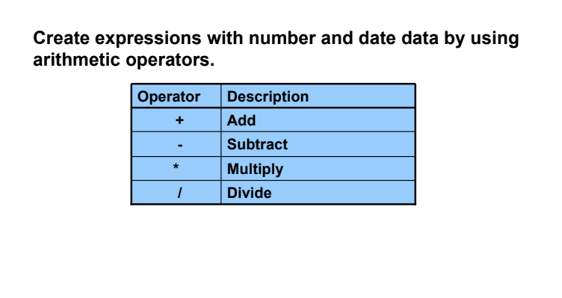
Arithmetic Expressions

Slide 21
Example

Slide 22
WILDCARD CHARACTERS
Databases often treat % and _ as wildcard characters
Syntax:
SELECT col_name FROM table_name WHERE col_name LIKE ‘%a’

Slide 23
WILDCARD CHARACTERS
Wildcard Character Description
% The percent wildcard specifies that any characters can appear in multiple
positions represented by the wildcard.
_ The underscore wildcard specifies a single position in which any character
can occur.

Slide 24
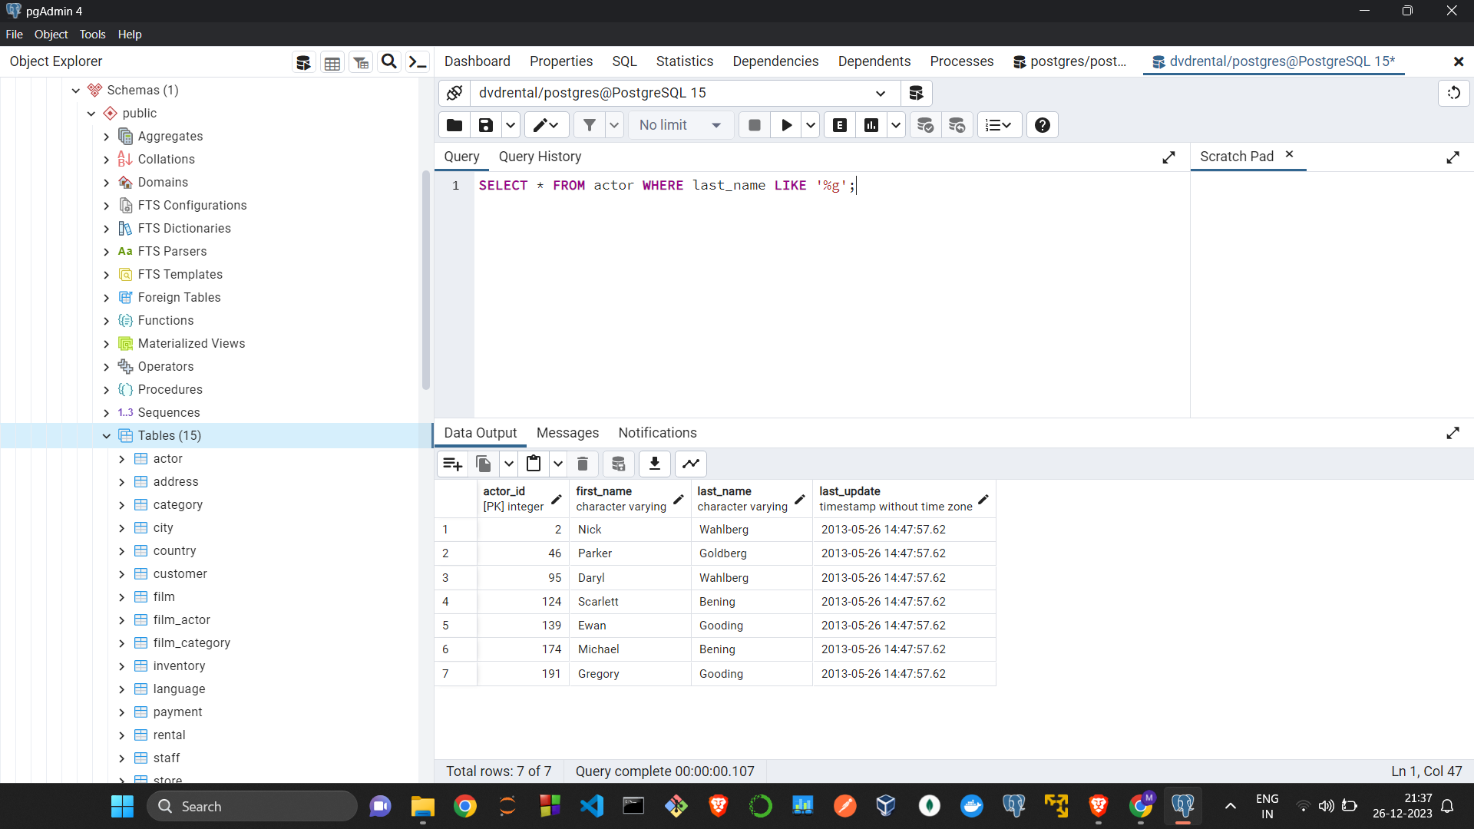
WILDCARD CHARACTERS
Example Using %:

Slide 25
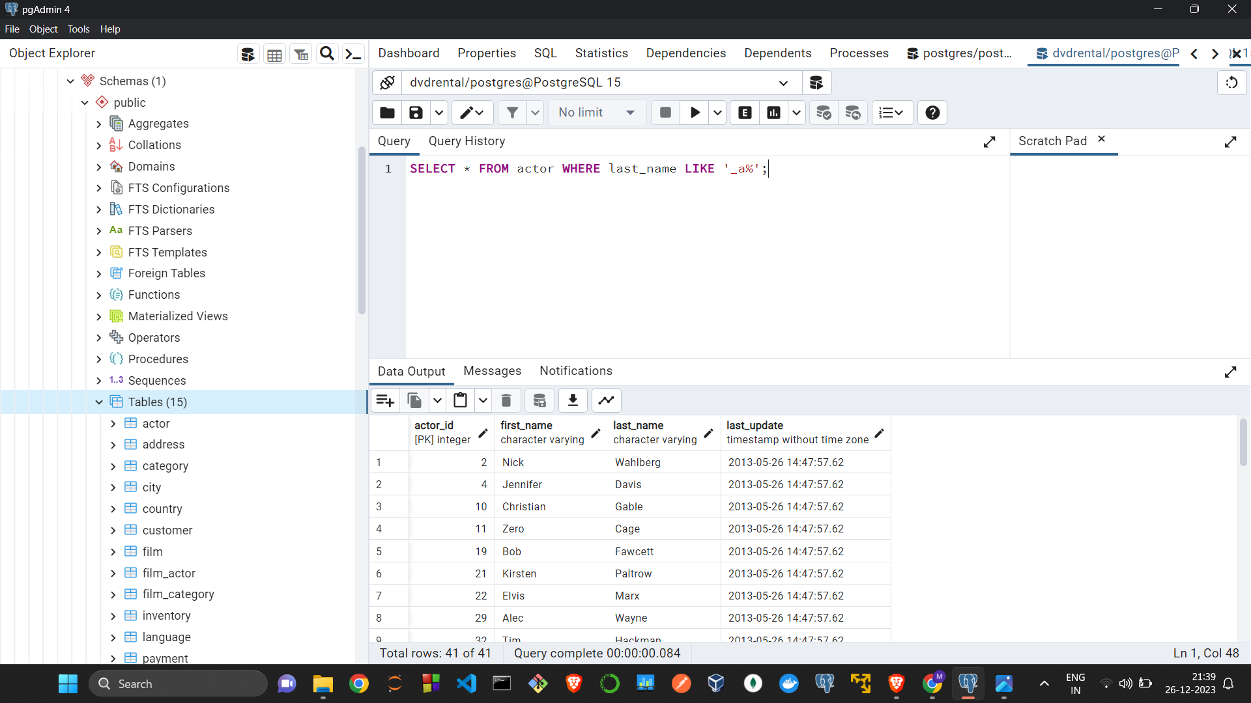
WILDCARD CHARACTERS
Example Using _:

Slide 26
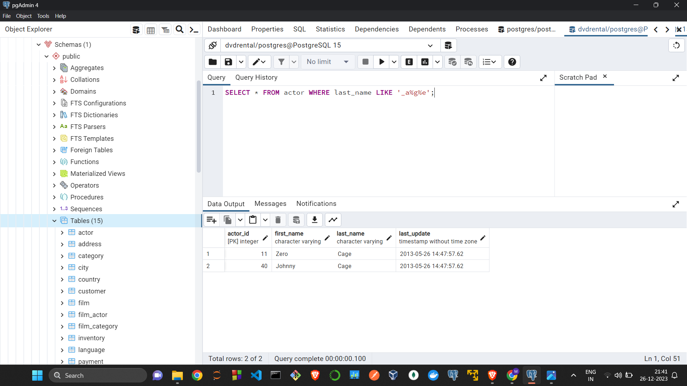
WILDCARD CHARACTERS
Example Using _ and %:

Slide 27
Using the IN keyword
In SQL, the IN keyword is used in a WHERE clause to filter the result set based on a specified list of values. It allows you to specify multiple values in a condition, and the query will return rows where the value in the specified column matches any of the values in the list.
Syntax:
SELECT column1, column2, ...
FROM table_name
WHERE column_name IN (value1, value2, ...);

Slide 28
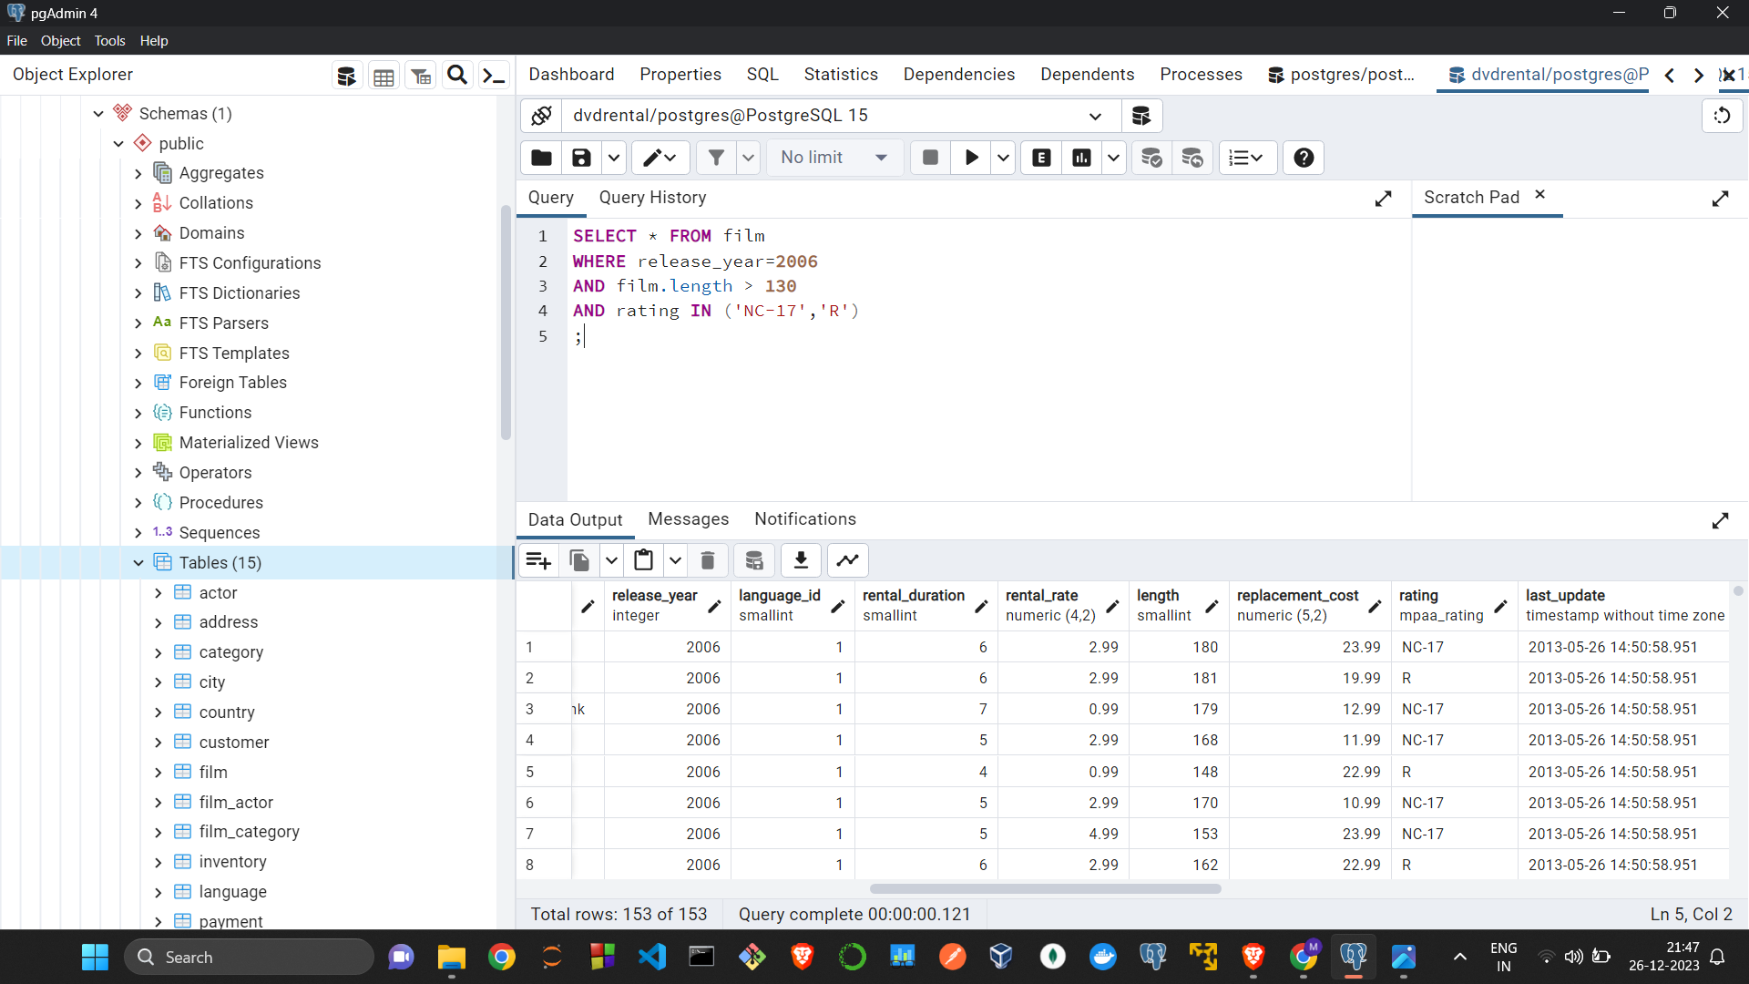
Using the IN keyword
Example:

Slide 29
Aggregate Functions
Syntax
SELECT COUNT(column1), AVG(column2), MAX(column3), MIN(column4),SUM(col5)
FROM table_name;

Slide 30
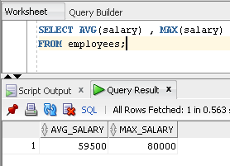
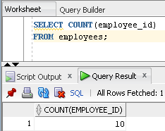
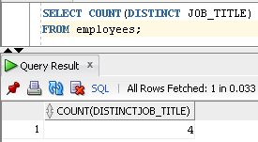
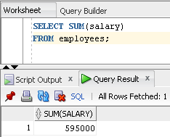
Example

Slide 31
GROUP BY
Syntax
SELECT column1, COUNT(column2)
FROM table_name
GROUP BY column1;

Slide 32
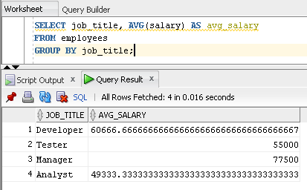
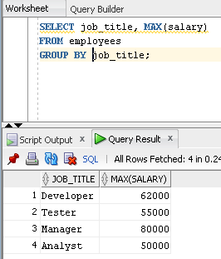
Example

Slide 33
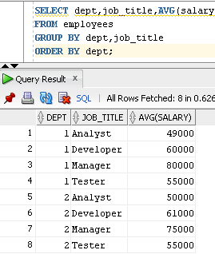
Example

Slide 34
HAVING
Syntax
SELECT col1, AGGFUN(col2)
FROM employees
GROUP BY col1
HAVING AGGFUN(col) > n;

Slide 35
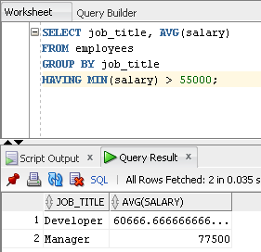
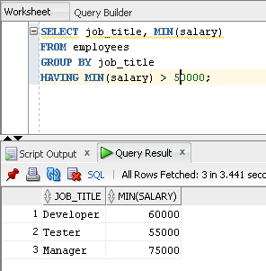
Example

Slide 36
FETCH FIRST
Syntax
SELECT column1, column2
FROM table_name
FETCH FIRST n ROWS ONLY;

Slide 37
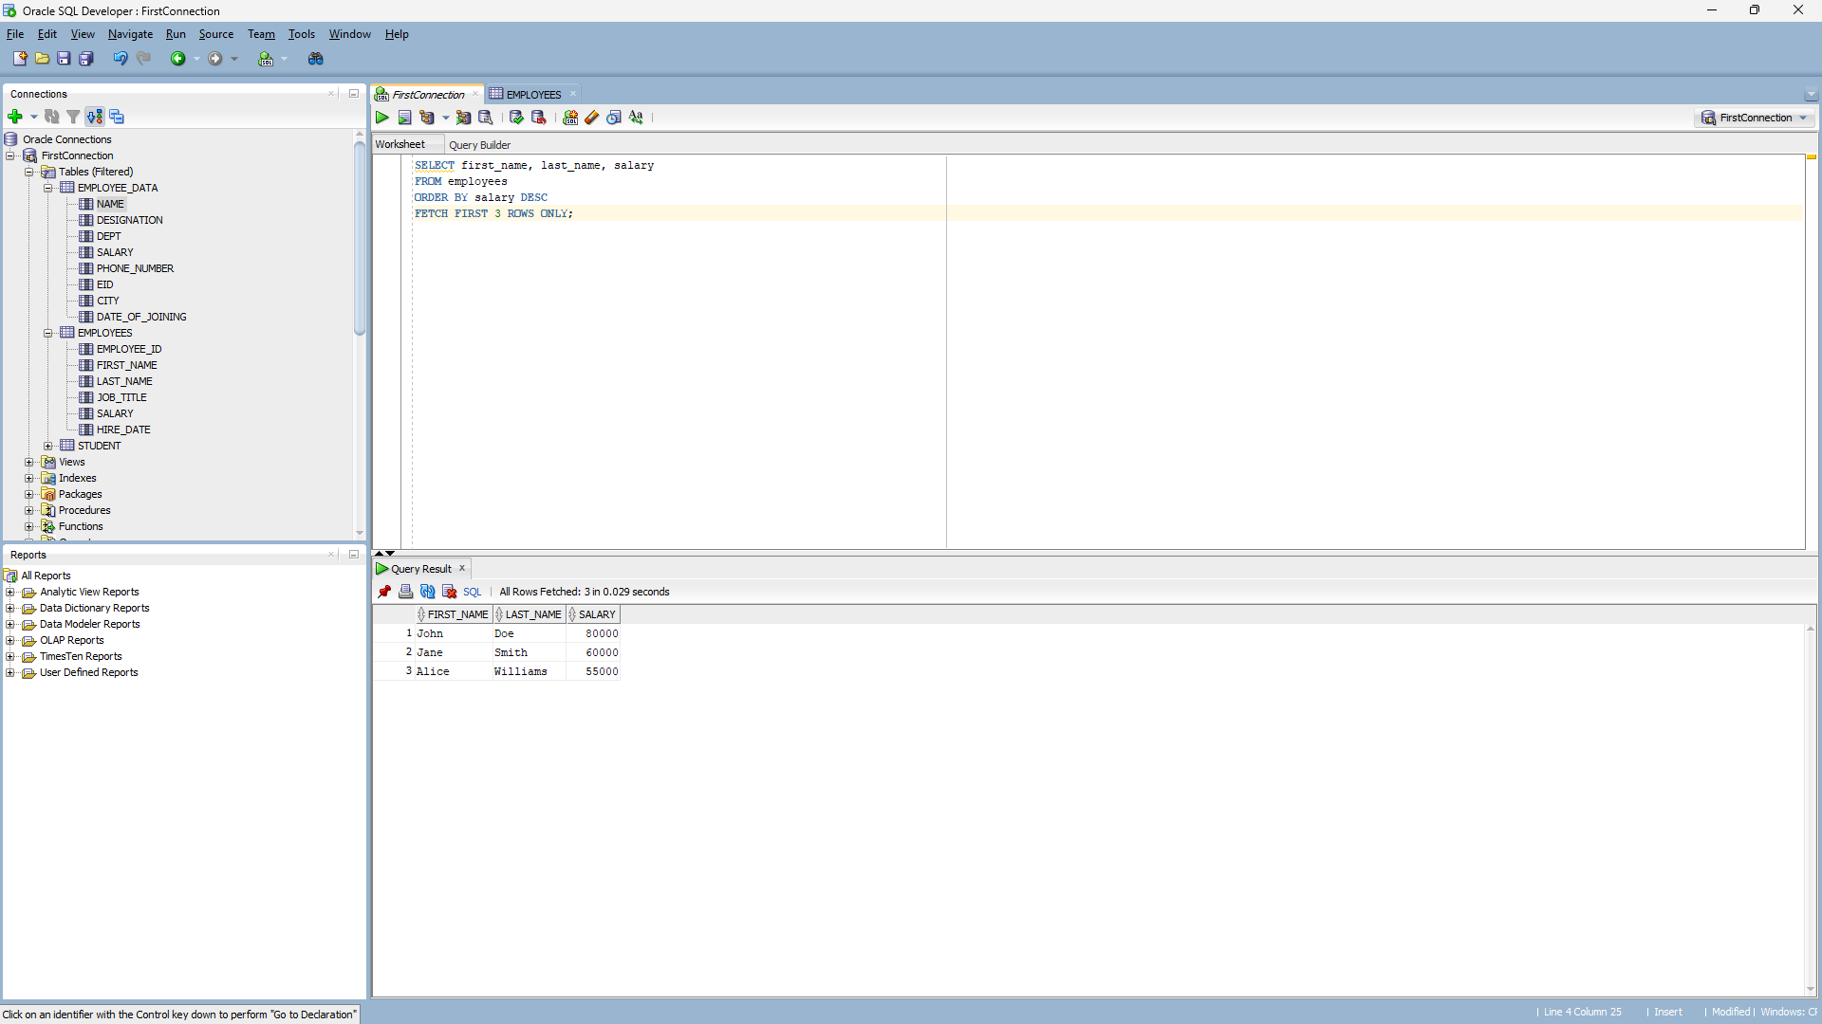
Example

Slide 38
Selecting From Dual Table
DUAL is a table automatically created by Oracle Database along with the data dictionary. DUAL is in the schema of the user SYS but is accessible by the name DUAL to all users. It has one column, DUMMY, defined to be VARCHAR2(1), and contains one row with a value X.
Selecting from the DUAL table is useful for computing a constant expression with the SELECT statement. Because DUAL has only one row, the constant is returned only once

